Slide 1
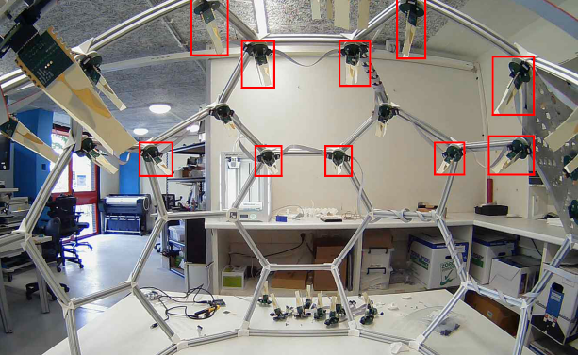
ADome GUI

Slide 2
Content
Adome project
GUI Systemarchitecture
GUI Requirements
Schedule
Current state
Current and future tasks
Possible obstacles

Slide 3
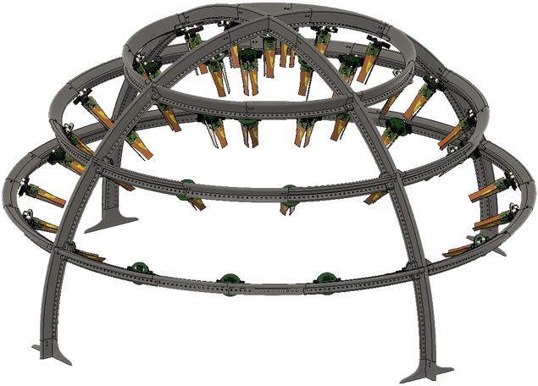
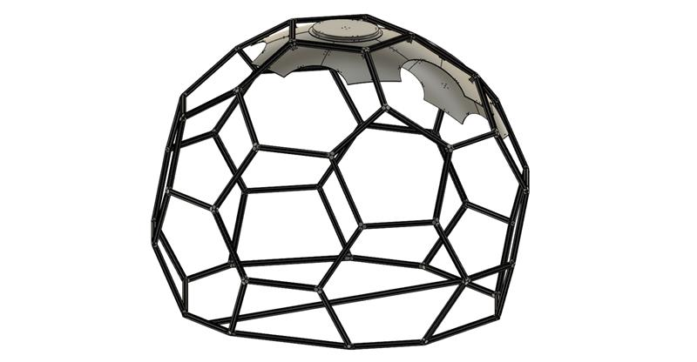
ADome project
ADome
Optical Calibration System (OCS)
CAN bus

Slide 4
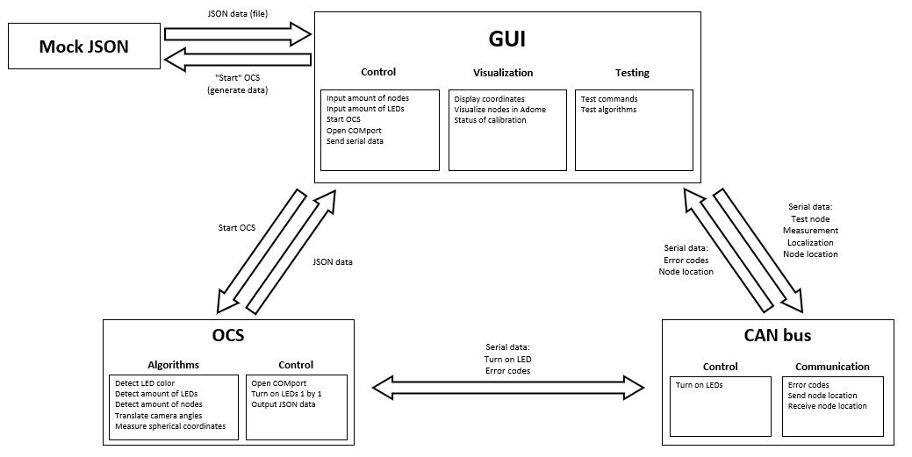
GUI Systemarchitecture

Slide 5
GUI Requirements
GUI
Input amount of measuring nodes. (Must)
Start button. (Must)
Show the coordinates of nodes. (Must)
Text box for user feedback from the GUI (error codes etc.. (Must)
Node testing commands. (Should)
Visualize nodes in a polar or spherical coordinate model of the ADome. (Should)
Command interface for sending serial data to CAN bus. (Could)
Show orientation of the nodes. (Could)
Visualize nodes in a 3D model of the ADome. (Could)
Algorithms
Turn on a combination of four LEDs one by one with OCS. (Must)
Call OCS three times for different positions of the camera within the ADome by pressing a button. (Must)
Write a mock function that creates JSON test input and output data, so it corresponds to the actual data from the OCS. (Must)
Write a function that displays the generated JSON data. (Must)
Compare the amount of nodes found by OCS against the amount of nodes declared in the GUI. (Must)
Write back the coordinates of the node to that specific node with CAN bus. (Could)
Call OCS three times for different positions of the camera within the ADome automatically. (Could)
Retrieve the coordinates from the nodes with CAN bus. (Could)
Determine orientation of the nodes. (Could)
Translate the position of the camera to the middle of the dome. (Won’t)

Slide 6
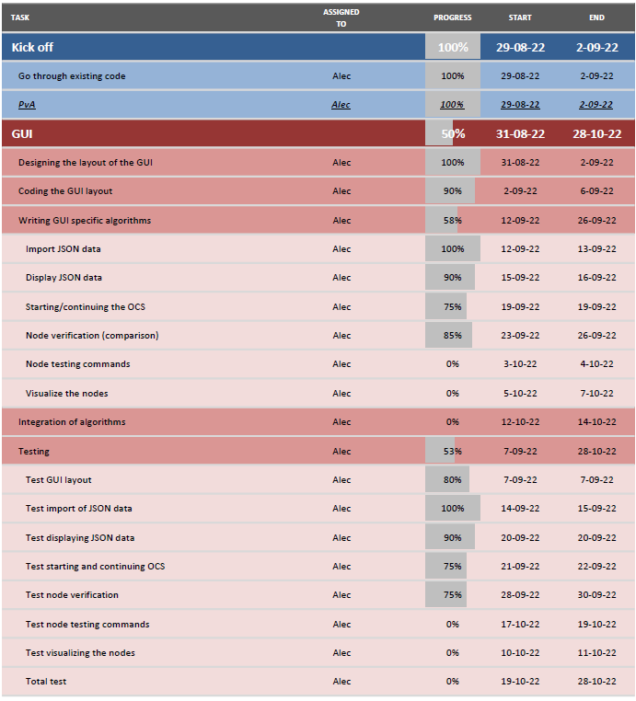
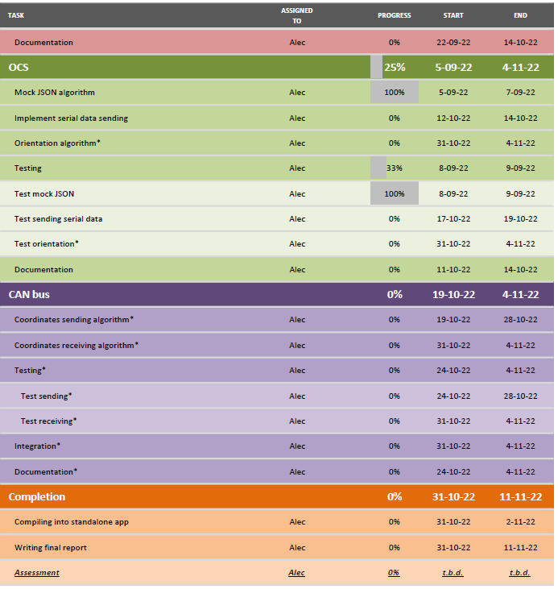
Schedule (progression)

Slide 7
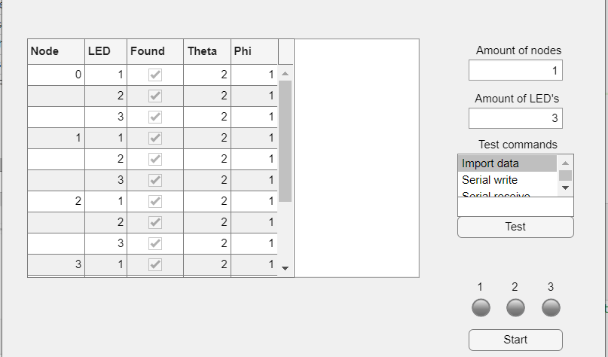
Current state of the GUI
GitHub
Starting OCS multiple times, verifying and displaying data.
Displaying data from the command window i.e. error codes and status of the OCS/GUI/CAN bus.
Demonstration

Slide 8
Current and (near) future tasks
Possibility of using timers.
Sending commands from the GUI to CAN bus.
Visualizing the nodes in the GUI.
Documentation

Slide 9
Possible obstacles
The OCS not working/not finished in the testing stage.
CAN bus not working when testing.
Antennas not working when testing.
Integration taking too long.

Slide 10
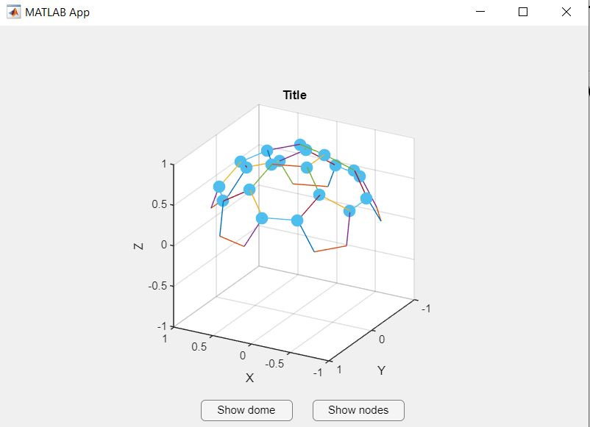
Current state (4-10-2022) visualizing nodes GUI

Slide 11
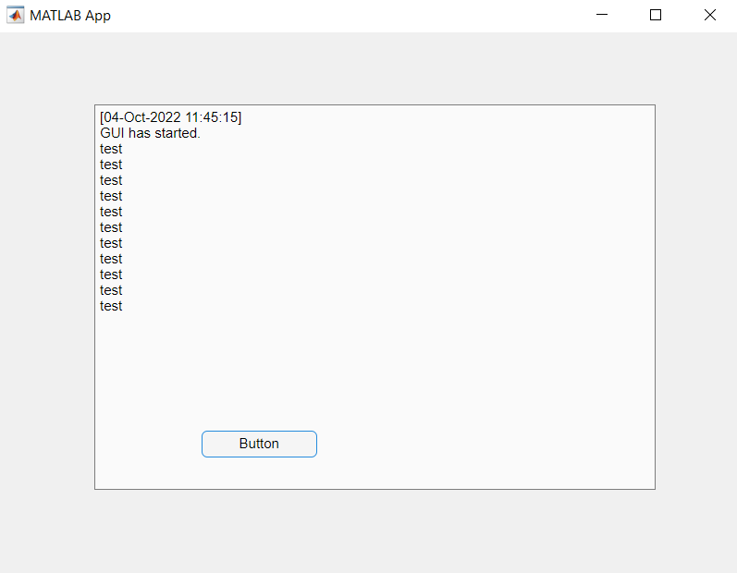
Command window to textbox GUI
Using printf() to send data to command window, then read command window and display it. Using button to repeatedly print “test” in command window and then display it in GUI.

Slide 12
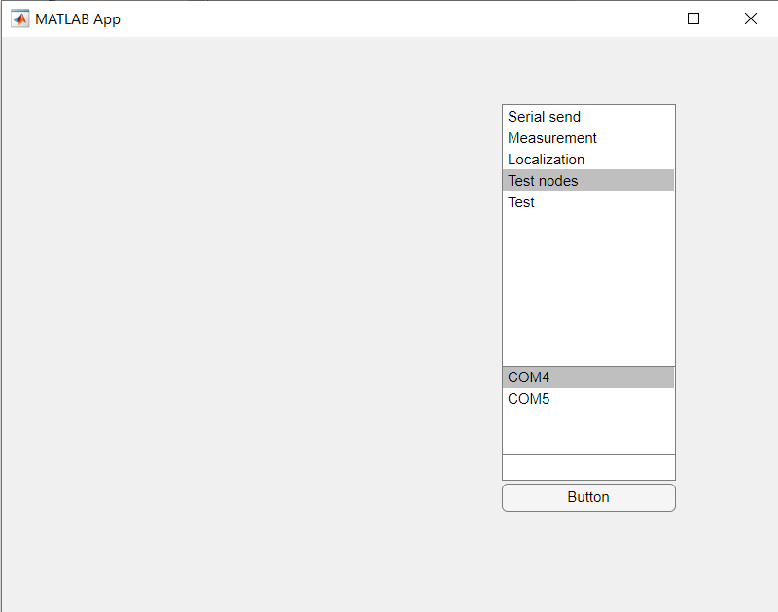
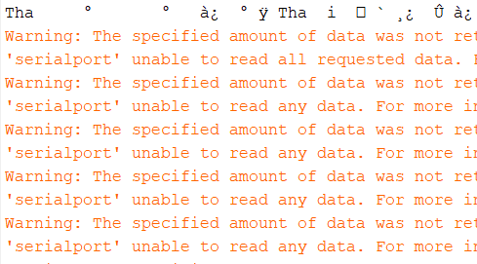
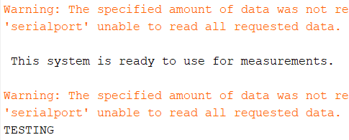
Node commands GUI
The black tekst is output data from the CAN bus master. The warnings are because there is no data to read from the COM port and it is waiting on the master.
After using “test” command (first sending “i” to initiate CAN bus master and then sending “a” to receive “TESTING”

Slide 13
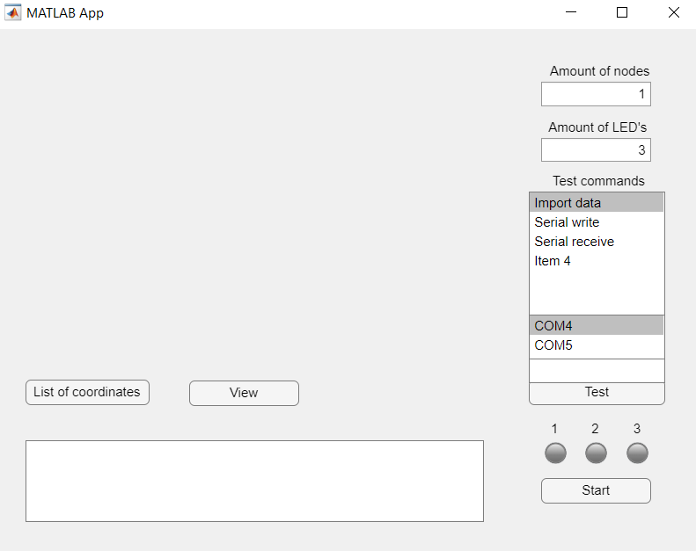
ADome GUI normal state

Slide 14
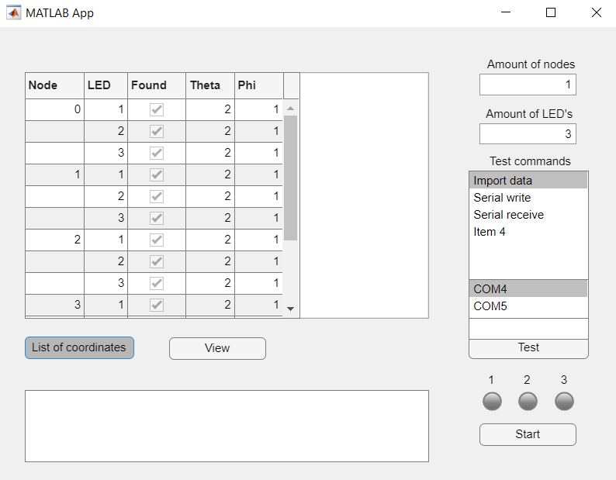
ADome GUI list of coordinates state

Slide 15
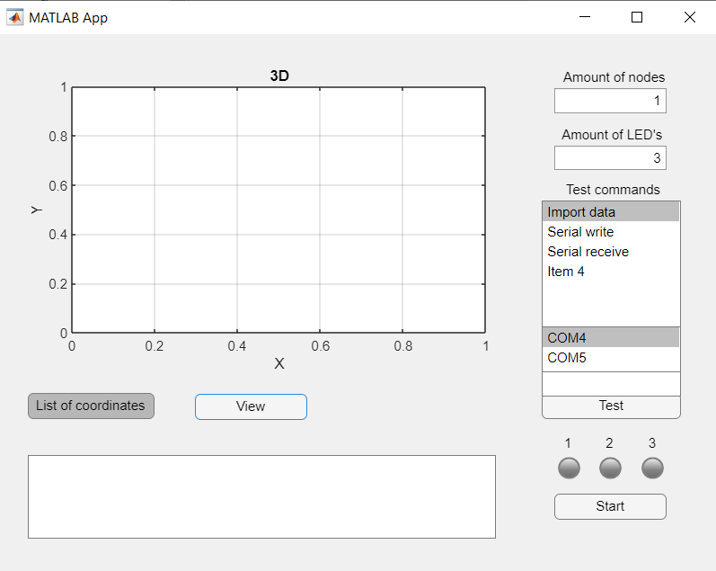
ADome GUI visualize nodes state

Slide 16
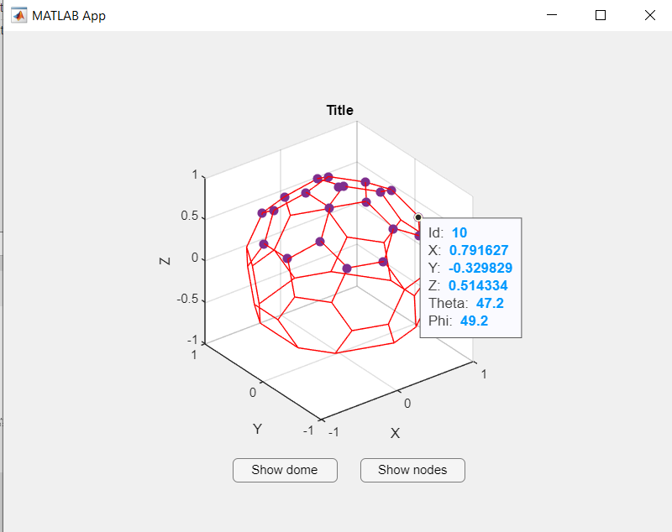
Update (4-10-2022) visualizing nodes GUI

